Slide 1
ExploreAtlas:
Your Guide to Uncharted Adventures

Slide 2
Introduction
ExploreAtlas is your ultimate guide to discover and helping others discover the world’s most captivating destinations
Viewpoints
Camping Spots
Trekking Routes
And any such amazing terrains that interests you to explore

Slide 3

Basic Functionality
Go, change the world
RV College of
Engineering
Any USER can view the SPOTS in the atlas
Registered Users (Voyagers) will be able to add
Spots
Reviews
Comments

Slide 4
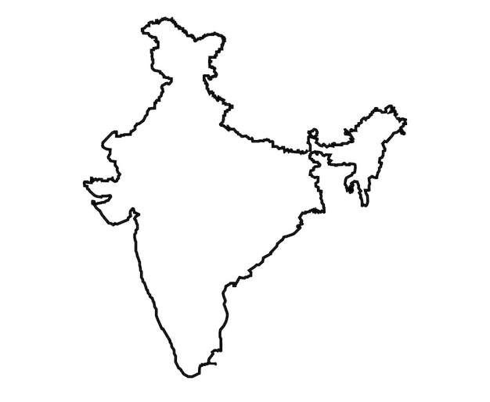


Advanced Functionality
Go, change the world
RV College of
Engineering
Registered Users (Voyagers) will be able to add
Spots
LOCATION you add is reflected as CHECKPOINTS on the MAP

Slide 5
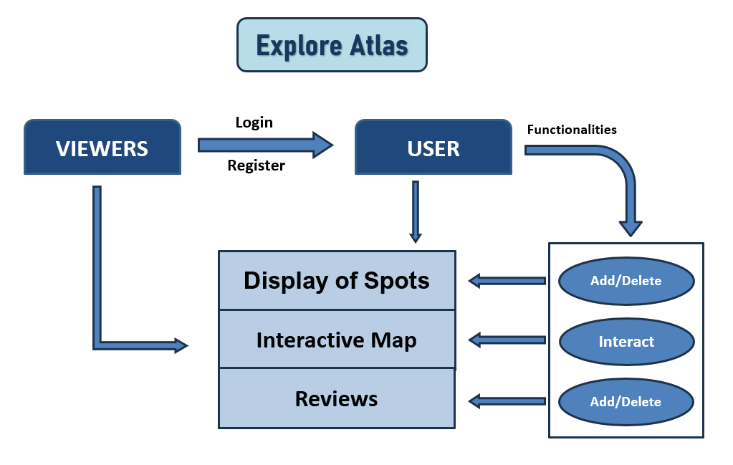
FLOW of the APPLICATION
Go, change the world
RV College of
Engineering

Slide 6
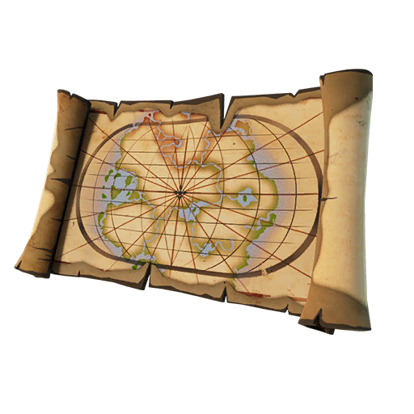
BRAND IDENTITY
Go, change the world
RV College of
Engineering
ExploreAtlas
Brand Identity: Our brand mark incorporates a map-inspired design to emphasize exploration and discovery
Design is inspired from the popular video game Uncharted which follows a crew of treasure hunters who travel across the world to uncover various historical mysteries

Slide 7


TECH STACK
Go, change the world
RV College of
Engineering
Templating engine for Node.js
Allows us to embed JavaScript within HTML
<% javascript code %>
Dynamic Content

Slide 8



TECH STACK
Go, change the world
RV College of
Engineering
Server-side JavaScript runtime environment
Node.js provides runtime environment for executing JavaScript code on server side
Express provides the framework for handling HTTP requests, defining routes, and sending responses
Express runs on top of Node.js and provides a higher-level API for building web applications and APIs
NoSQL database for handling hierarchical data (user profiles, reviews, location details)
Mongoose for ODM (Object Data Modeling)
It maps data from the Database into Application and vice versa

Slide 9







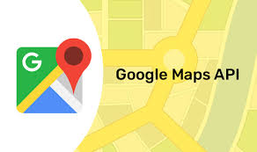
SERVICES/APIs
Go, change the world
RV College of
Engineering
CLOUD
To store IMAGES of the Spots
MongoDB Atlas
Handles all the complexity of deploying and managing
MongoDB deployments on cloud
(AWS, Google Cloud, Cloudinary)
MAPS
APIs that provide interactive maps to mark the locations

Slide 10
ARCHITECTURE
Go, change the world
RV College of
Engineering
User login or register
Display of spots as a LIST as well on the interactive MAP
Users can ADD - Location and Photos of a new spot
Users can Review and Comment on the location

Slide 11



HOSTING
Go, change the world
RV College of
Engineering
Once we have a functional web application, we can deploy it on the web for everyone

Slide 12
Thank You
Go, change the world
RV College of
Engineering

